Slide 1


School of Computer Science and Engineering
Department of Computer Science and Engineering
FusionLV
AI-Powered Diagnosis of Livedoid Vasculopathy
Submitted By:
Gurnoor Kaur
2427030134
Supervised By:
Ms. Bali Devi

Slide 2

Outline
Introduction
Literature Review
Problem Statement
Objectives
Flowchart(Problem Solution)
Image Preprocessing and CNN Model Training Pipeline
References

Slide 3

INTRODUCTION
Livedoid vasculopathy (LV) is a rare thrombotic skin disorder characterized by painful ulcerations that heal into distinctive porcelain-white scars. It mostly effect the lower limbs bilaterally.
The condition's clinical presentation overlaps significantly with vasculitic and ulcerative disorders, creating a diagnostic maze that leads to:
Frequent misdiagnosis
Delayed treatment initiation

Slide 4
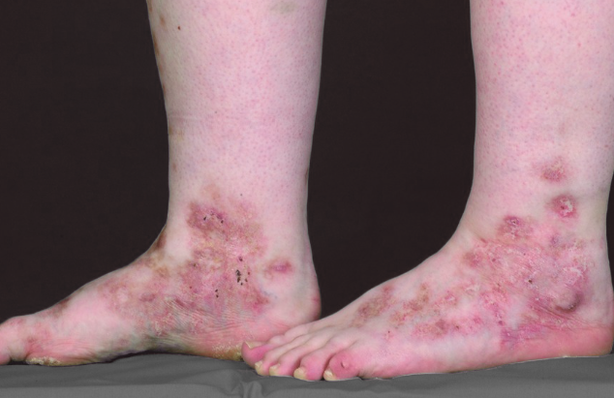
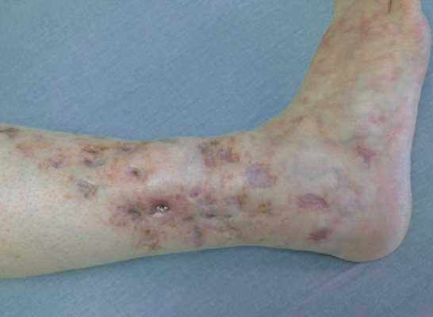
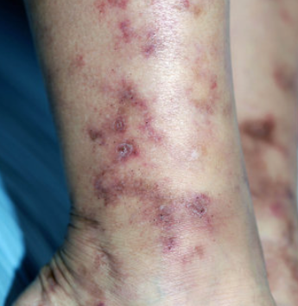
Representative Clinical Images and Key Symptoms of Livedoid Vasculopathy
Painful ulcers on the lower legs or ankles
Livedo reticularis pattern — net-like purplish skin discoloration
Atrophie blanche — white, scar-like patches after healing
Burning or stinging sensation in affected areas

Slide 5
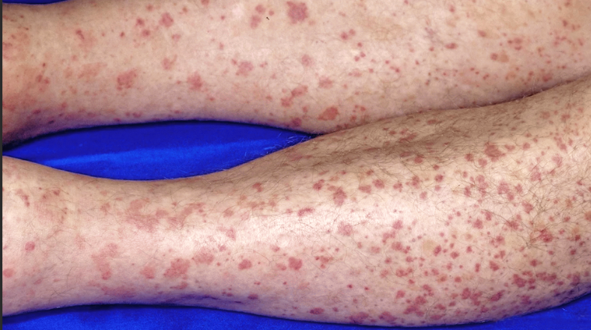
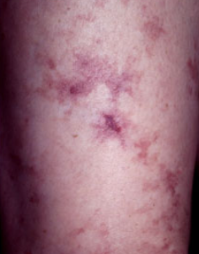
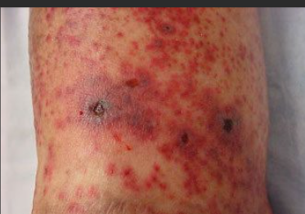
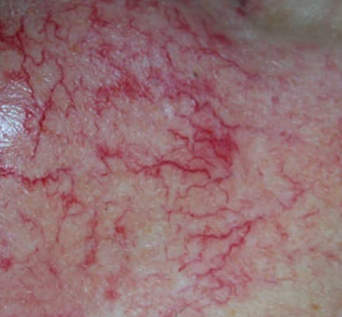
Diseases that resemble livedoid vasculopathy
Leukocytoclastic vasculitis
Livedo reticulari
Cutaneous Vasculitis Lesions
Telangiectasia

Slide 6
Literature Review

Slide 7

2019–2021
AI models (like CNNs) started matching dermatologists in spotting common skin diseases like melanoma. [1]
2023
Explainable AI became popular. These models show doctors what parts of the image they focused on—making it easier to trust the results. [3]
1
2
4
3
2022
New AI systems began combining images with patient info (like age, symptoms, lab results). This made diagnosis 15–23% more accurate than using images alone. [2]
2024
A major gap was found: no AI tools were built for rare skin diseases like livedoid vasculopathy, even though the technology is ready and proven. [4]

Slide 8
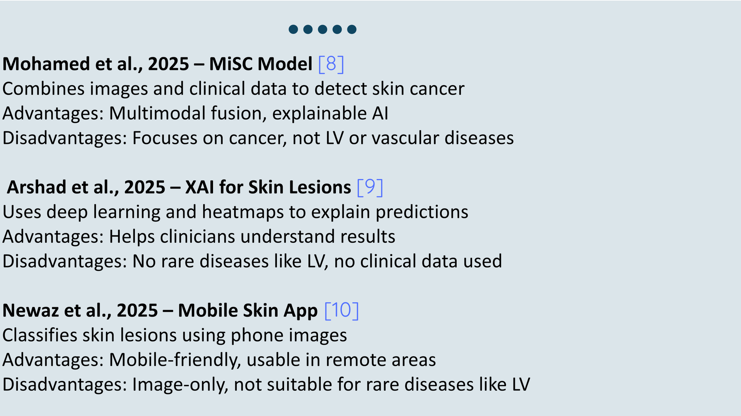
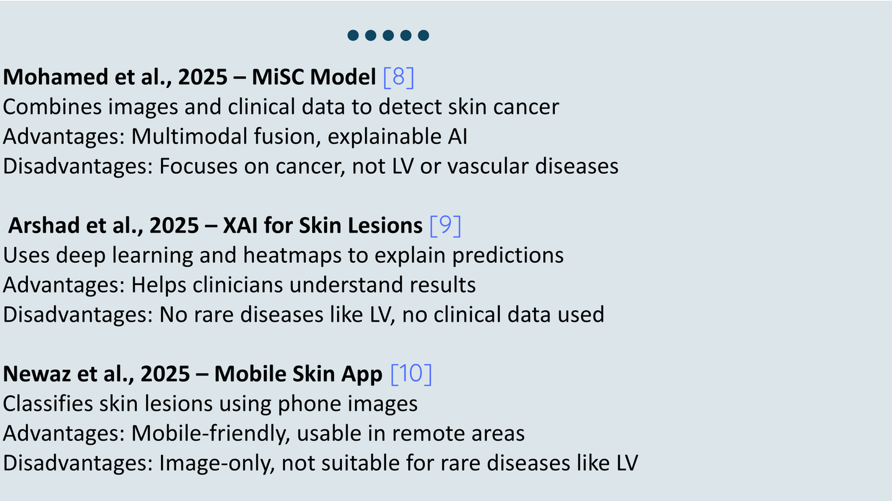

Slide 9
Research Gaps
Limited Availability of Livedoid Vasculopathy Datasets
There is no large, standardized, or public dataset for LV images or clinical data, making AI training difficult. [5]
Lack of Multimodal Integration
Existing dermatology AI models rely mostly on image-only inputs, while LV diagnosis requires clinical, histopathological, and patient-level data integration. [6]
Poor Generalization Across Devices, Skin Tones, and Institutions
AI models in dermatology often fail to generalize due to domain shifts, lighting variations, and bias toward lighter skin types.[7]

Slide 10

The Problem Statement
Accurate diagnosis of Livedoid Vasculopathy is challenging due to limited datasets, visual overlap with similar diseases, and lack of AI-based tools. Existing methods are subjective and time-consuming, highlighting the need for an automated, explainable, and multimodal AI diagnostic framework.

Slide 11


Project Objectives
Build a multimodal AI model to detect Livedoid Vasculopathy using images and clinical data.
Differentiate LV from similar skin disorders using advanced classification

Slide 12
Project Objectives
Develop a prototype app for clinicians to upload images, enter data, and get explainable diagnoses.
Test with dermatologists* to ensure accuracy, clarity, and clinical usability.

Slide 13
FLOWCHART (PROBLEM SOLUTION)
Step | Stage | Solution Approach | Technologies
1 | Data Collection | Collect images and patient metadata (multimodal data). | Python, Cloud Storage
2 | Data Preparation | Clean, resize, label, and augment data for training. | Python, Image Preprocessing
3 | Model Development | Train AI models using image and metadata inputs. | AI, ML, DL, CNN
4 | Model Evaluation & Explainability | Evaluate performance and add visual explanations. | XAI, Evaluation Metrics
5 | Deployment | Build an app for real-time LV prediction. | Web App Tools, Cloud Services
6 | Clinical Validation & Feedback | Test with doctors and refine based on feedback. | Clinical Testing, Feedback Loop

Slide 14
System Overview & Workflow
AI-Based Image Processing Pipeline for Livedoid Vasculopathy
Developed an academic web-based prototype using Streamlit.
Demonstrates the complete machine learning pipeline on dermatological images.
Dataset organized into two classes:
LV_like and Other
Workflow:
Image loading from local dataset
Image preprocessing and hair artifact removal
Data augmentation for small datasets
Feature extraction (texture, edge, shape)
CNN-based classification using transfer learning
Visualization of training performance

Slide 15

Image Preprocessing, Augmentation & Feature Extraction
Image Preprocessing Implemented:
Resizing all images to 224 × 224
Conversion to grayscale to focus on texture patterns
Hair removal using morphological filtering and inpainting
Normalization for stable model training
Feature Extraction Demonstrated:
Canny Edge Detection – boundary detection
Local Binary Pattern (LBP) – texture analysis
Histogram of Oriented Gradients (HOG) – shape and gradient features
Data Augmentation Techniques:
Rotation
Zooming
Horizontal flipping
Brightness adjustment
(Used to increase dataset diversity and reduce overfitting)

Slide 16
Model Training, Results & Conclusion
Model Training Approach:
Used MobileNetV2 (pretrained on ImageNet) for transfer learning
Chosen due to limited dataset size
Added custom classification layers on top of pretrained model
Dataset split into training and validation sets
Results Displayed on Web Interface:
Training accuracy and validation accuracy
Training loss and validation loss curves
Demonstrates real learning behavior of the model
Conclusion:
The system successfully demonstrates an end-to-end AI pipeline
Focuses on methodology and workflow rather than clinical accuracy
Suitable for academic evaluation and learning purposes

Slide 17

References
1. Han et al. (2020)
Classification of the clinical images for benign and malignant cutaneous tumors using a deep learning algorithm
Journal of Investigative Dermatology
https://www.nature.com/articles/nature21056
2. Tschandl et al. (2020)
Human–computer collaboration for skin cancer recognition
Nature Medicine
https://www.nature.com/articles/s41591-020-0942-0
Liu et al. (2021)
A multimodal deep learning framework for skin disease diagnosis
IEEE Transactions on Medical Imaging
https://www.frontiersin.org/journals/medicine/articles/10.3389/fmed.2021.626369/full
3. Graziani et al. (2022)
Explainable AI for dermatology: Visualizing model attention and feature importance
Medical Image Analysis
https://www.sciencedirect.com/science/article/abs/pii/S1361841522001219?via%3Dihub

Slide 18
References
4. Zbrzezny & Krzywicki (2025)
Artificial Intelligence in Dermatology: A Review of Methods, Clinical Applications, and Perspectives Applied Sciences
https://www.mdpi.com/2076-3417/15/14/7856
5. Luo et al., 2023 – Artificial Intelligence-Assisted Dermatology Diagnosis, Computers in Biology and Medicine, Elsevier.
https://doi.org/10.1016/j.compbiomed.2023.107878
6. Chiou et al., 2024 – Multimodal Image Dataset for AI-Based Skin Cancer (MIDAS), NEJM AI.
https://ai.nejm.org/doi/full/10.1056/AIdbp2400732
7. Daneshjou et al., 2022 – Disparities in Dermatology AI Performance on Diverse Skin Tones, Nature Medicine.
https://pubmed.ncbi.nlm.nih.gov/35960806

Slide 19
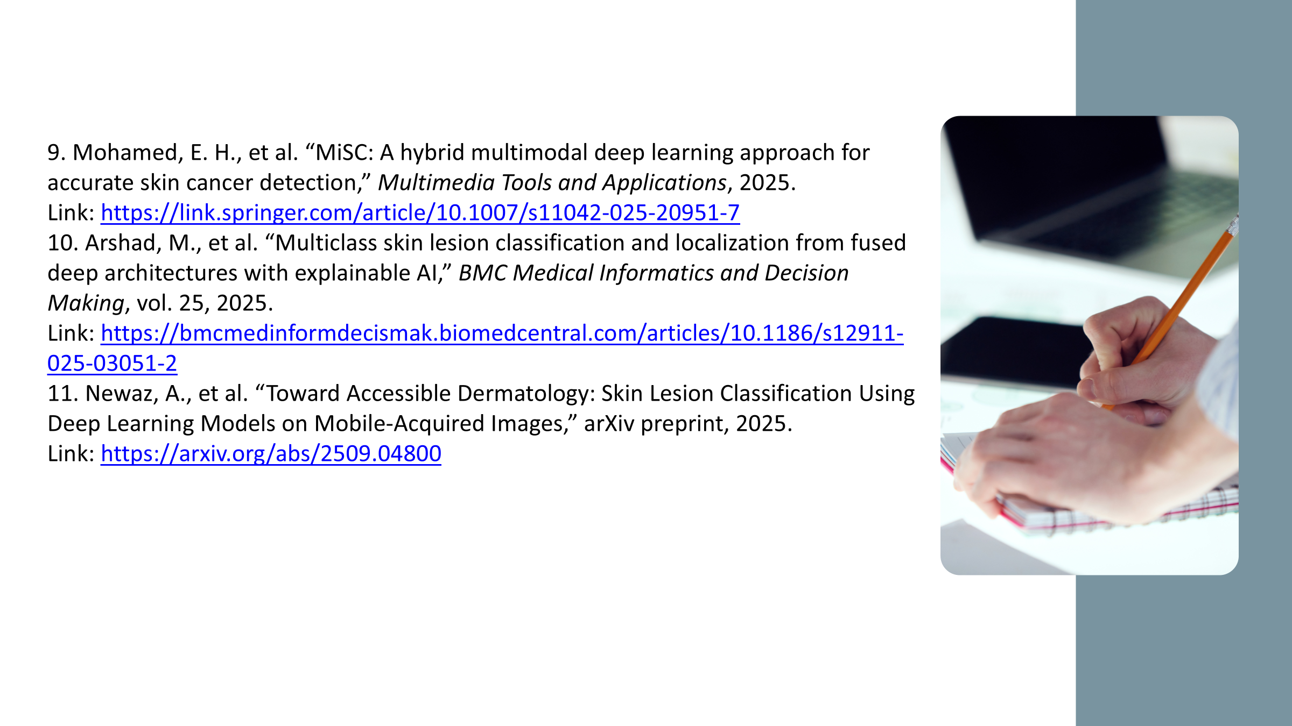
References

Slide 20

THANK YOU.........

